Slide 1
Лекция 11. Material Design

Slide 2
О чем
Launch Screen
Cards
SnackBar
ActionBar
Floating Action Button
CoordinatorLayout
Tabs
Bottom Navigation Bar
Navigation Drawer

Slide 3
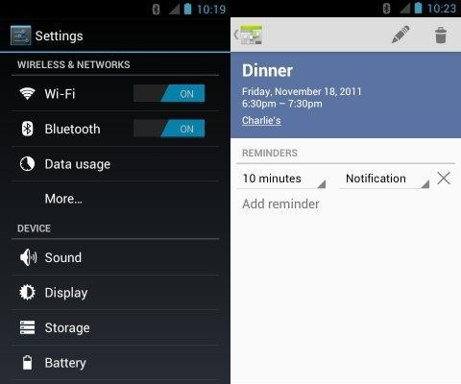
Android 4.x Holo

Slide 4
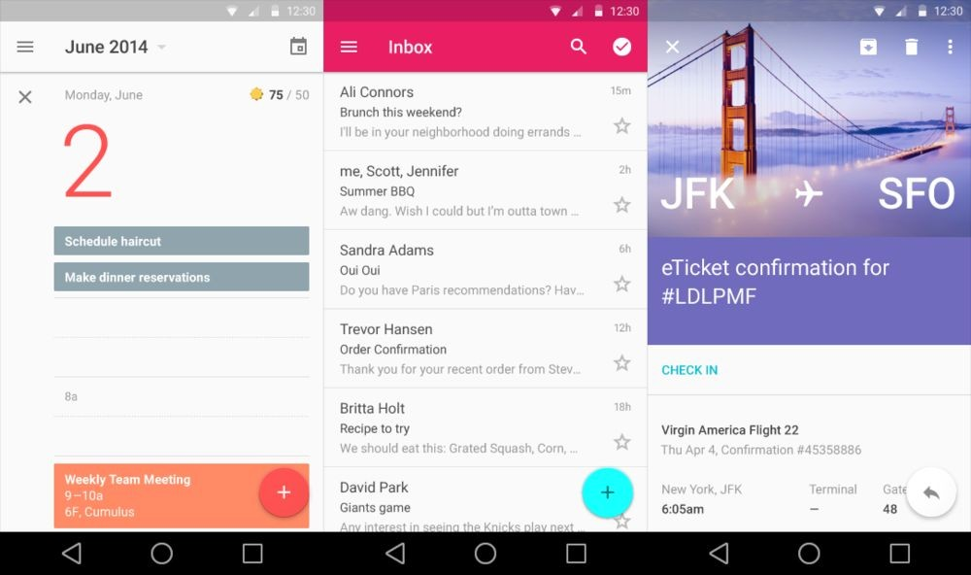
Современный Android

Slide 5
MaterialDesign
build.gradle
dependencies {
...
compile 'com.android.support:design:27.0.+'
}
9

Slide 6
SplashScreen
public class SplashScreen extends AppCompatActivity implements
AsyncNotesLoader.LoaderDelegate {
@Override
protected void onCreate(Bundle savedInstanceState) {
super.onCreate(savedInstanceState);
AsyncNotesLoader loader = new AsyncNotesLoader(this);
}
@Override
public void onNotesLoaded() {
Intent intent = new Intent(this, MainActivity.class);
startActivity(intent);
finish();
}
}

Slide 7
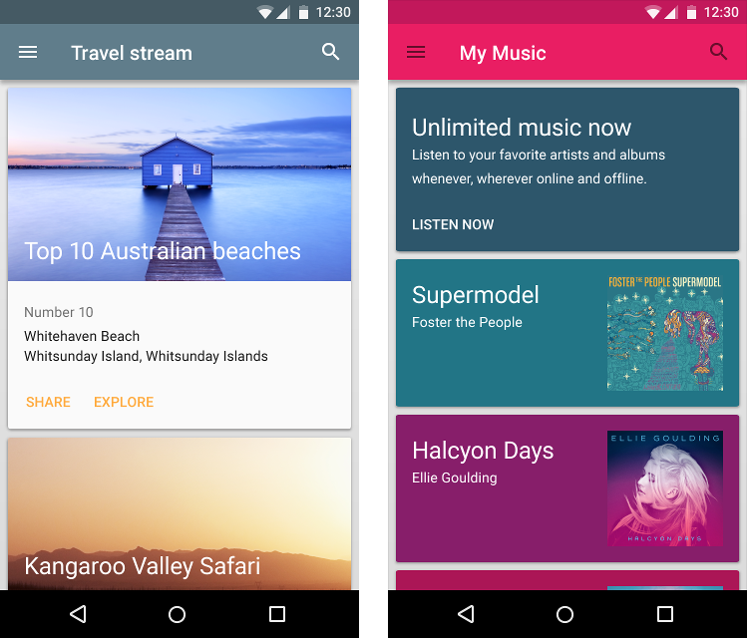
CardView

Slide 8
CardView
dependencies {
...
compile 'com.android.support:cardview-v7:27.0.2' compile 'com.android.support:recyclerview-v7:27.0.2' compile 'com.android.support:design:27.0.2'
}

Slide 9
CardView
<?xml version="1.0" encoding="utf-8"?>
<LinearLayout xmlns:android="http://schemas.android.com/apk/res/android" android:orientation="vertical" android:layout_width="match_parent" android:layout_height="match_parent">
<android.support.v7.widget.CardView xmlns:card_view="http://schemas.android.com/apk/res-auto" android:id="@+id/card_view" android:layout_gravity="center" android:layout_width="200dp" android:layout_height="200dp" card_view:cardCornerRadius="4dp">
<TextView
android:id="@+id/info_text" android:layout_width="match_parent" android:layout_height="match_parent" />
</android.support.v7.widget.CardView>
</LinearLayout>

Slide 10
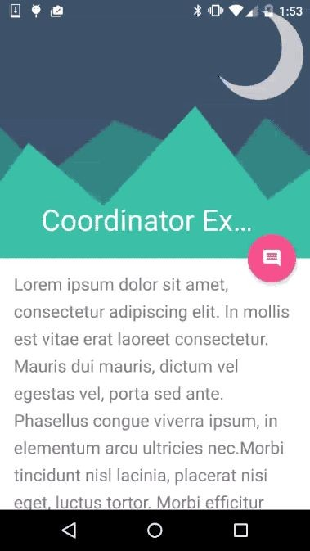
CoordinatorLayout

Slide 11
CoordinatorLayout
Основная задача - координация View
С помощью якорей
С помощью Behavior
Возможности
Перехват касаний
Перехват прокрутки NestedScrollView

Slide 12
CoordinatorLayout
Использование якорей
<android.support.design.widget.AppBarLayout android:id="@+id/appBar">
<android.support.design.widget.CollapsingToolbarLayout>
<android.support.v7.widget.Toolbar/>
</android.support.design.widget.CollapsingToolbarLayout>
</android.support.design.widget.AppBarLayout>
<include layout="@layout/content_main" />
<android.support.design.widget.FloatingActionButton android:id="@+id/toolbarfab" android:layout_width="wrap_content" android:layout_height="wrap_content" android:layout_margin="@dimen/fab_margin"
app:layout_anchor="@id/appBar"
app:layout_anchorGravity="bottom|right|end"
app:srcCompat="@android:drawable/ic_popup_reminder" />

Slide 13
CoordinatorLayout
Использование Bahavior
<android.support.design.widget.FloatingActionButton android:id="@+id/fab" android:layout_width="wrap_content" android:layout_height="wrap_content" android:layout_gravity="bottom|end" android:layout_margin="@dimen/fab_margin"
app:layout_behavior="com.github.kirillf.materialdemo.HidingFABBehavior" app:srcCompat="@android:drawable/ic_dialog_email" />
<LinearLayout xmlns:android="http://schemas.android.com/apk/res/android" xmlns:app="http://schemas.android.com/apk/res-auto" android:orientation="vertical"
android:layout_width="match_parent" android:layout_height="match_parent"
app:layout_behavior="@string/appbar_scrolling_view_behavior">

Slide 14
CoordinatorLayout.Behavior
public static abstract class Behavior< V extends View> {
public Behavior(Context context, AttributeSet attrs);
public boolean onInterceptTouchEvent();
public boolean onTouchEvent();
public int getScrimColor();
public float getScrimOpacity();
public boolean onDependentViewChanged();
public void onDependentViewRemoved();
public boolean onStartNestedScroll(); public void onNestedScrollAccepted(); public void onNestedPreScroll(); public void onNestedScroll();
public void onStopNestedScroll();
public boolean onNestedPreFling()
public boolean onNestedFling();
public void onRestoreInstanceState();
public onSaveInstanceState();
}

Slide 15
Свой Behavior
public class FancyFrameLayoutBehavior extends
CoordinatorLayout.Behavior<FloatingActionButton> {
public FancyFrameLayoutBehavior(Context c, AttributeSet a) {
}
@Override
public boolean onStartNestedScroll(CoordinatorLayout l,
FloatingActionButton c, View directTargetChild,
View target, int axes, int type) {
return true;
}
@Override
public void onNestedScroll(CoordinatorLayout l,
FloatingActionButton c, View t, int dxConsumed,
int dyConsumed, int dxUnconsumed,
int dyUnconsumed, int type) {
//do your stuff
}
}

Slide 16
Стандартные Behavior
ScrollingViewBehavior

Slide 17
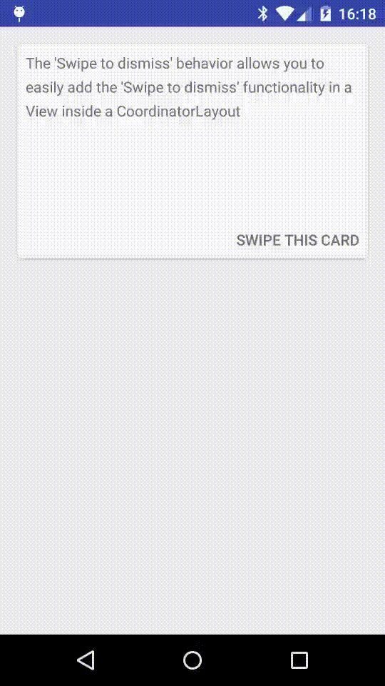
SwipeDismissBehavior

Slide 18
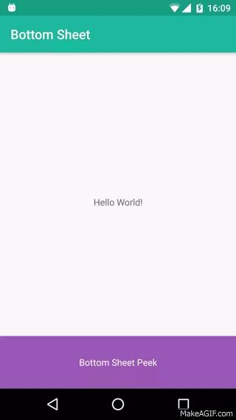
BottomSheetBehavior

Slide 19

ActionBar
Панель верхней части приложения
Появилась в Android 3.0
Обычно предоставляет доступ к наиболее частым действиям
Теперь называется Toolbar (API 21)
Hamburger Menu
Title
Menu
19

Slide 20
ActionBar
<RelativeLayout android:layout_width="match_parent" android:layout_height="match_parent">
<android.support.v7.widget.Toolbar android:id="@+id/toolbar" android:layout_height="wrap_content" android:layout_width="match_parent" android:minHeight="?android:attr/actionBarSize" app:theme="@style/ActionBarStyle"
/>
…
</RelativeLayout>
20

Slide 21
ActionBar
MainActivity.java
@Override
public void onCreate(Bundle savedInstanceState) {
super.onCreate(savedInstanceState);
setContentView(R.layout.main_layout);
Toolbar toolbar = (Toolbar)findViewById(R.id.toolbar); setSupportActionBar(toolbar);
}
21

Slide 22
ActionBar
res/values-v21/styles.xml
<resources>
<style name="AppTheme" parent="Theme.AppCompat.Light.NoActionBar">
res/values/styles.xml
<resources>
<style name="AppTheme" parent="Theme.AppCompat.Light">
AndroidManifest.xml
<application android:theme="@style/AppTheme"
22

Slide 23
ActionBar
res/menu/main_menu.xml
<?xml version="1.0" encoding="utf-8"?>
<menu xmlns:android="http://schemas.android.com/apk/res/android" xmlns:app="http://schemas.android.com/apk/res-auto">
<item android:id="@+id/menu_sorttype" android:icon="@android:drawable/ic_menu_sort_by_size"
android:title="@string/sort_menu" app:showAsAction="always"/>
<item android:id="@+id/settings" app:showAsAction="never" android:title="@string/settings"/>
</menu>
23

Slide 24
ActionBar
MainActivity.java
@Override
public void onCreateOptionsMenu(Menu menu, MenuInflater inflater) { super.onCreateOptionsMenu(menu, inflater); inflater.inflate(R.menu.main_menu, menu);
MenuItem item = menu.findItem(R.id.settings);
}
@Override
public boolean onOptionsItemSelected(MenuItem item) { boolean called = super.onOptionsItemSelected(item); if (!called) {
switch (item.getItemId()) {
case R.id.settings:
called = true; //your code here
break;
}
}
return called;
}
22

Slide 25
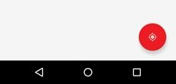
Floating Action Button
Появилось в Android 5.0 (API 21)
Предоставляет доступ к часто используемому действию

Slide 26
Floating Action Button
<RelativeLayout xmlns:android="http://schemas.android.com/apk/res/android" xmlns:tools="http://schemas.android.com/tools" android:layout_width="match_parent" android:layout_height="match_parent">
<android.support.design.widget.FloatingActionButton android:id="@+id/fab" android:layout_width="wrap_content" android:layout_height="wrap_content" android:layout_alignParentBottom="true" android:layout_alignParentEnd="true" android:layout_margin="24dp" android:backgroundTint="@color/colorPrimary"/>
</RelativeLayout>

Slide 27
Floating Action Button
private void setupFab(View rootView) { FloatingActionButton fab =
(FloatingActionButton)rootView.findViewById(R.id.fab); VectorDrawableCompat icon =
VectorDrawableCompat.create(getResources(), R.drawable.ic_add_white_24px, null);
icon.setTint(Color.WHITE); fab.setImageDrawable(icon); fab.setOnClickListener(new View.OnClickListener() {
@Override
public void onClick(View view) { addNewNote();
}
});
}

Slide 28
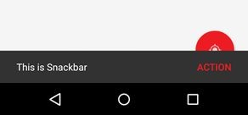
SnackBar
Современная замена Toast
Интерактивный
Дает возможность совершить действие

Slide 29
SnackBar
Snackbar.make(rootView, R.string.note_added, Snackbar.LENGTH_SHORT)
.setAction("Action", MainActivity.this)
.show();
}
16

Slide 30
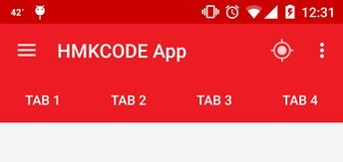
TabLayout
Появилось в SupportLibrary 23
Позволяет осуществлять навигацию по горизонтали
На данный момент рекомендуется заменить на BottomNavigation (если элементов от 2 до 5)

Slide 31
TabLayout
<RelativeLayout android:layout_width="match_parent" android:layout_height="match_parent">
<android.support.v7.widget.Toolbar/>
<android.support.design.widget.TabLayout android:id="@+id/tabLayout" android:scrollbars="horizontal" android:layout_below="@+id/toolbar" android:layout_width="match_parent" android:layout_height="wrap_content" android:background="?attr/colorPrimary" app:layout_scrollFlags="scroll|enterAlways" />
<FrameLayout android:id="@+id/main_fragment_container"/>
</RelativeLayout>

Slide 32
TabLayout
MainActivity.java
@Override
public void onCreate(Bundle savedInstanceState) {
super.onCreate(savedInstanceState);
setContentView(R.layout.main_layout);
TabLayout tabLayout = (TabLayout) findViewById(R.id.tabLayout); tabLayout.setTabGravity(TabLayout.GRAVITY_FILL); tabLayout.addTab(tabLayout.newTab().setText("Tab 1"));
tabLayout.addTab(tabLayout.newTab().setText("Tab 2"));
tabLayout.addTab(tabLayout.newTab().setText("Tab 3")); tabLayout.addOnTabSelectedListener(this);
}
@Override
public void onTabSelected(TabLayout.Tab tab) {
}

Slide 33
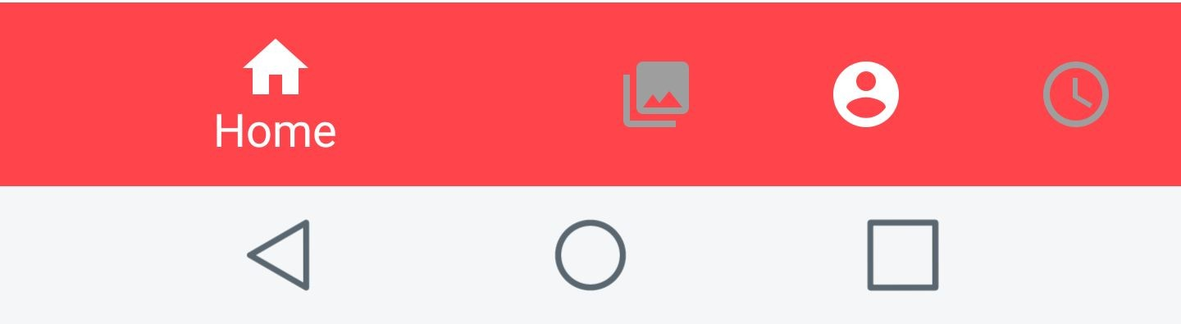
BottomNavigationView
Появилось в SupportLibrary 25
Позволяет осуществлять навигацию по горизонтали
Ограничено небольшим числом секций (3-5)

Slide 34
BottomNavigationView
<RelativeLayout android:layout_width="match_parent" android:layout_height="match_parent">
<android.support.v7.widget.Toolbar />
<FrameLayout android:id="@+id/main_fragment_container" />
<android.support.design.widget.BottomNavigationView android:id="@+id/bottom_navigation" android:layout_width="match_parent" android:layout_height="wrap_content" android:layout_alignParentBottom="true" app:itemBackground="@color/colorPrimary" app:itemIconTint="@android:color/white" app:itemTextColor="@android:color/white" app:menu="@menu/bottom_navigation_main" />
</RelativeLayout>

Slide 35
BottomNavigationView
<?xml version="1.0" encoding="utf-8"?>
<menu xmlns:android="http://schemas.android.com/apk/res/android" xmlns:app="http://schemas.android.com/apk/res-auto">
<item
android:id="@+id/action_favorites" android:icon="@drawable/ic_add_white_24px" android:title="@string/add_card_menu_item" app:showAsAction="ifRoom" />
<item
android:id="@+id/action_schedules" android:icon="@drawable/ic_mode_edit_white_24px" android:title="@string/edit_card_menu_item" app:showAsAction="ifRoom" />
<item
android:id="@+id/action_music" android:icon="@drawable/ic_settings_white_24px" android:title="@string/settings"
app:showAsAction="ifRoom" />
</menu>
40

Slide 36
BottomNavigationView
MainActivity.java
@Override
public void onCreate(Bundle savedInstanceState) { super.onCreate(savedInstanceState); setContentView(R.layout. activity_lesson_list);
BottomNavigationView bottomNavigationView = (BottomNavigationView) findViewById(R.id. bottom_navigation);
bottomNavigationView.setOnNavigationItemSelectedListener(
new BottomNavigationView.OnNavigationItemSelectedListener() { @Override
public boolean onNavigationItemSelected(MenuItem item) {
switch (item.getItemId()) {
case R.id.action_favorites:
case R.id.action_schedules:
case R.id.action_music:
}
return true;
}
});
41
}

Slide 37
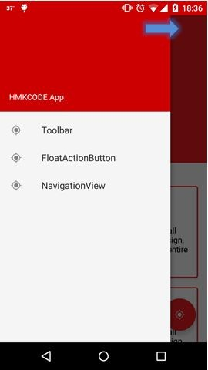
NavigationView
Перемещение внутри иерархии приложения
Если не хватает места для BottomNavigation
Дает возможность добавлять
большой список секций
Может быть спрятан
HeaderView
menu
42

Slide 38
NavigationView
<android.support.v4.widget.DrawerLayout xmlns:android="http://schemas.android.com/apk/res/android" xmlns:app="http://schemas.android.com/apk/res-auto" android:id="@+id/drawer_layout" android:layout_width="match_parent" android:layout_height="match_parent" android:fitsSystemWindows="true">
<RelativeLayout>
<android.support.v7.widget.Toolbar/>
<FrameLayout android:id="@+id/main_fragment_container"/>
</RelativeLayout>
<android.support.design.widget.NavigationView android:id="@+id/navigation_view" android:layout_width="wrap_content" android:layout_height="match_parent" app:headerLayout="@layout/navigation_view_header_layout" app:menu="@menu/navigation_drawer_menu" android:layout_gravity="start">
</android.support.design.widget.NavigationView>
</android.support.v4.widget.DrawerLayout>

Slide 39
NavigationView
<?xml version="1.0" encoding="utf-8"?>
<LinearLayout xmlns:android="http://schemas.android.com/apk/res/android" android:layout_width="match_parent" android:layout_height="192dp" android:background="?attr/colorPrimaryDark" android:padding="16dp" android:theme="@style/ThemeOverlay.AppCompat.Dark" android:orientation="vertical"
android:gravity="bottom">
<TextView
android:layout_width="match_parent" android:layout_height="wrap_content" android:text="@string/app_name" android:textAppearance="@style/TextAppearance.AppCompat.Body1"/>
</LinearLayout>

Slide 40
NavigationView
res/menu/navigation_drawer_menu.xml
<?xml version="1.0" encoding="utf-8"?>
<menu xmlns:android="http://schemas.android.com/apk/res/android">
<group android:id="@+id/group_main" android:checkableBehavior="single">
<item
android:id="@+id/nav_add_deck" android:title="@string/create_deck"/>
</group>
<group android:id="@+id/group_settings" android:checkableBehavior="single">
<item
android:id="@+id/nav_settings" android:title="@string/settings"/>
</group>
</menu>

Slide 41
NavigationView
MainActivity.java
@Override
public void onCreate(Bundle savedInstanceState) { super.onCreate(savedInstanceState); setContentView(R.layout.main_layout);
mNavView = (NavigationView)findViewById(R.id.navigation_view); mDrawer = (DrawerLayout)findViewById(R.id.drawer_layout); mNavView.setNavigationItemSelectedListener(this);
}
@Override
public boolean onNavigationItemSelected(MenuItem item) {
mDrawer.closeDrawers();
}

Slide 42
NavigationView
@Override
public void onCreate(Bundle savedInstanceState) { super.onCreate(savedInstanceState); setContentView(R.layout.main_layout);
Toolbar toolbar = (Toolbar)findViewById(R.id.toolbar); toolbar.setHomeButtonEnabled(true); toolbar.setDisplayHomeAsUpEnabled(true); toolbar.setHomeAsUpIndicator(R.drawable.ic_menu);
}
@Override
public boolean onOptionsItemSelected(MenuItem item) {
if (item.getItemId() == android.R.id.home) { mDrawer.openDrawer(GravityCompat.START); return true;
}
return super.onOptionsItemSelected(item);
}

